Slide 1


Zomato Restaurants Analysis
Vikram Gharami
09/10/2024

Slide 2

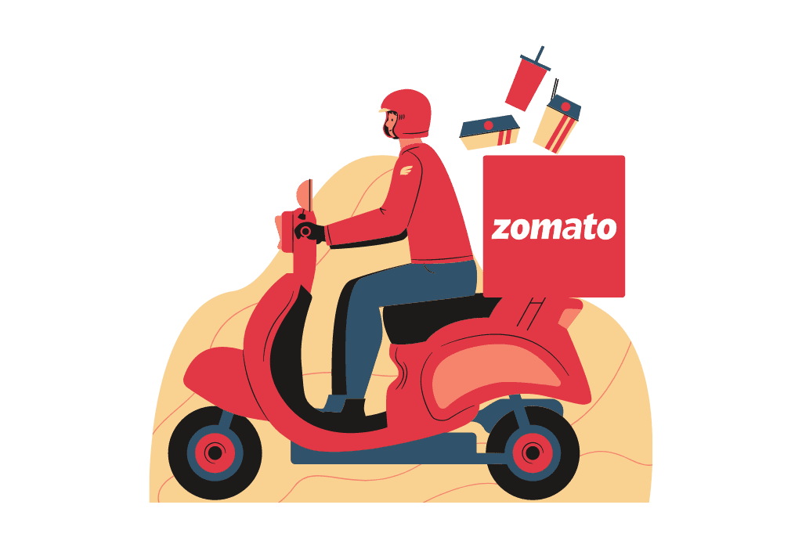
About Zomato
The global online food delivery market was valued at approximately $130 billion in 2023 and is expected to grow at a CAGR of 10.7% from 2024 to 2030, making it one of the fastest-growing industries worldwide.
"Zomato, with a presence in over 25 countries, partners with more than 1.5 million restaurants globally, shaping the dining experience of millions every day."
In India, Zomato holds a significant market share in the food delivery space, competing closely with Swiggy. As of 2023, Zomato had captured about 45-50% of the online food delivery market in India. "On Zomato, Biryani is the most ordered dish in India, with an average of 1 Biryani order placed every 3 seconds."

Slide 3

Business Objective
Objective: As a consultant data analyst for Zomato, the primary task is to develop data-driven strategies and recommendations for expanding the company’s business by opening new restaurants.
Key Focus:
Identify high-potential locations: Use data analysis to determine the most promising areas for new restaurant openings.
Market Demand Analysis: Analyze customer preferences, demand patterns, and competition to inform restaurant expansion plans.
Optimize Resources: Provide insights on resource allocation, ensuring that new restaurants are set up for success.
Strategic Growth: Align your recommendations with Zomato’s broader growth objectives and market positioning.

Slide 4
Data Description
Restaurant ID: Unique identifier for each restaurant.
Restaurant Name: The name of the restaurant.
Country Code: Country code of the location where the restaurant is situated.
City: The city where the restaurant is located.
Address: The specific address of the restaurant.
Locality: The locality or neighborhood where the restaurant is situated.
Locality Verbose: Detailed information about the locality.
Longitude: The geographical longitude coordinate of the restaurant.
Latitude: The geographical latitude coordinate of the restaurant.
Cuisines: The type of cuisine offered by the restaurant.
Currency: The currency used for transactions in the restaurant.
Country Code: The code assigned to a specific country that helps identify the country in raw data.
Country Name: Country name for the given country code.
Has_Table_booking: Indicates whether the restaurant has a table booking option (Yes/No).
Has_Online_delivery: Indicates whether the restaurant offers online delivery (Yes/No).
Is_delivering_now: Indicates whether the restaurant is currently delivering (Yes/No).
Switch_to_order_menu: Indicates whether users can switch to the order menu (Yes/No).
Price_range: A numeric value indicating the price range category of the restaurant.
Votes: The number of votes or ratings/(feedback) received by the restaurant.
Average_Cost_for_two: The average cost for two people dining at the restaurant.
Rating: The overall rating of the restaurant is based on user reviews.
Datekey_opening: The date when the restaurant was opened.

Slide 5
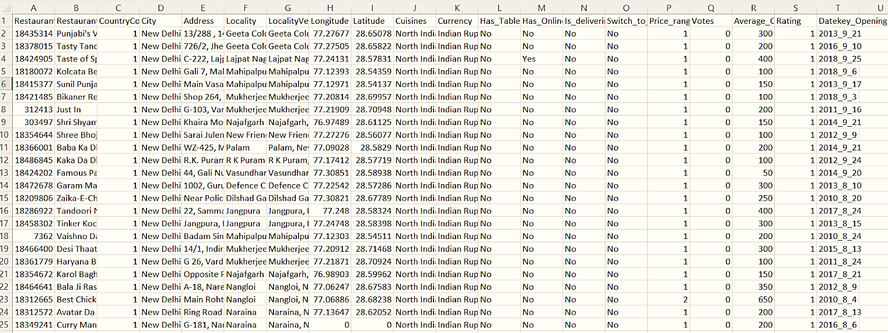
Dataset Overview

Slide 6
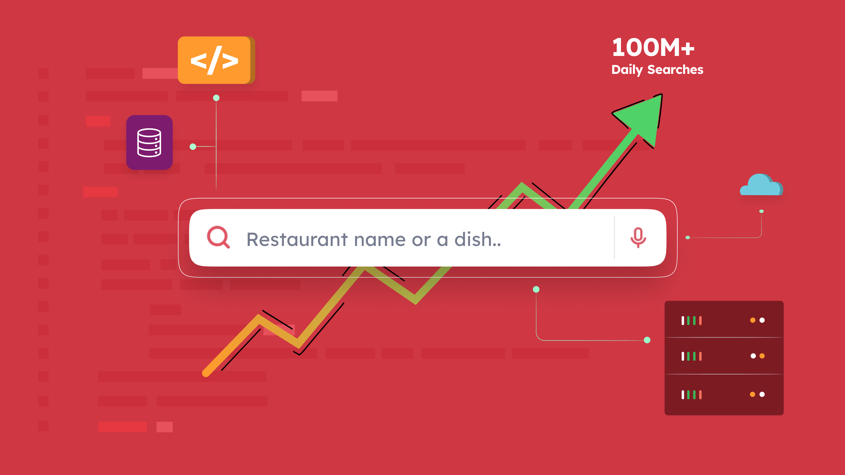

Dataset Preprocessing
There are 22 attributes present in the data across two tables as mentioned in the Data description slide.
There is no duplicates in the data but there are few blanks present in the cuisine column, Raw data file.
Votes record for 1094 restaurants are present as 0, these might be either new restaurants or customers has not voted them at all.
Average_cost_for_two seems to have 0 as value present for the few rows, which can be a data entry error.
Also, cross checked for duplicates present in the data using the ‘Remove Duplicates’ feature from the data tab in Excel.

Slide 7


Methodology
Data Cleaning: Removed inconsistent rows with blank "Cuisine" and "average_cost_for_two" values of '0' using the "Go to special" feature for cleaner data.
Data Enrichment: Added country names with VLOOKUP() for country codes and created an "Avg_Price_with_Currency" column using CONCATENATE(), MID(), FIND() for better readability with currency symbols.
Currency Conversion: Converted "Avg_Cost_for_two" to INR using XLOOKUP() based on exchange rates and added this as a new column in Raw_data from country_description worksheet.
Descriptive Analysis: Pivot table is used for summarizing key metrics and identifying Restaurants population patterns across the countries using bi-variate analysis and curate meaning insight.
Visualization & Dashboards: Developed dashboards, dynamic charts, and Cards using COUNTA(), SUM(), COUNTIFS(), AVERAGE(), IF(), array formulas, and CORREL() for meaningful analysis and data representation.

Slide 8

Data Analysis
Cleaned Data Overview:
Zomato has 9,542 restaurants across 15 countries, with 91% (8,652) located in India.
Total sales generated across countries, cities, and areas amount to ₹ 78,08,950.
Aggregated Data
Total Restaurants | 9542
Total Sales | ₹ 78,08,950
No of countries | 15
No of cuisine | 1825
No of cities | 140
The business spans 1825 unique cuisines in 140 cities, with restaurant ratings mostly between 2.4 to 5, averaging 2.9.
The average cost for two people is ₹ 818, and total votes from all restaurants are 1,495,919.
Only 26% of restaurants offer online delivery and 12% provide table booking services from total 9,542 restaurants.

Slide 9
Restaurants Trend Analysis
No. of Restaurants Opened in Each Country
As chart suggest highest number of the restaurants present in India (8652 or 91%), followed by USA (425) and UK (80) out of 9542 total restaurants.
The Country Canada has the least number of restaurants present after Qatar, Sri Lanka, Singapore with 4, 20, 20, and 20 restaurants respectively.
These number indicates that countries with the fewer restaurants have not saturated and have a huge market share to be acquired in such countries.

Slide 10
No. of Restaurants Opened in Each Year
The line chart shows a spike in new restaurant openings from 1,079 to 1,096 in 2011, followed by a sharp drop to 1,022 in 2012.
In 2013, openings increased to 1,059, but the trend declined in 2014 and 2015, with the lowest at 1,023.
After 2016, there was steady growth in restaurant openings for three consecutive years, suggesting the need to follow this trend for future openings.

Slide 11
Average number of voters in each country
Out of 1,49,591 total voters, Indonesia has the highest average voter count (772), followed by UAE (494) and Turkey (431).
‘Brazil’ has lowest voter count with 20, and ‘Singapore’ with 32 voters comes to second last in the avg. voters count.
Despite making up 91% of the dataset, India has only 137 voters, suggesting that voter count varies based on factors beyond population size.

Slide 12
Suggested Countries
Canada
Singapore
Sri Lanka
Australia
Country | Count of Restaurants | Average of Rating
Canada | 4 | 3.6
Qatar | 20 | 4.1
Singapore | 20 | 3.6
Sri Lanka | 20 | 3.9
Indonesia | 21 | 4.3
Philippines | 22 | 4.5
Australia | 24 | 3.7
Turkey | 34 | 4.3
New Zealand | 40 | 4.3
Brazil | 60 | 3.8
United Arab Emirates | 60 | 4.2
South Africa | 60 | 4.2
United Kingdom | 80 | 4.1
United States of America | 425 | 4.0
India | 8652 | 2.8
Grand Total | 9542 | 2.9
We can see in the table that Australia, Canada, Singapore and Sri Lanka are the countries with least number of restaurants and average rating of below 4.
Less number of restaurants and average rating indicates, less saturation in the market and less competition for the restaurants business.
Therefore, it would be a great opportunity for restaurant expansion in these countries, and further narrow down the approach for the targeted cities next.

Slide 13
Suggested Country-wise City
Avg. cost of two in Suggested Country / City
We selected average cost for two and rating as key metrics for targeting cities for new restaurant openings.
Singapore offers the highest food expenditure, a less saturated market, and is ideal for new openings.
Flaxton in Australia shows the highest revenue potential, making it the best choice in the region.
Canada has higher food expenditure than most Australian locations, except Flaxton, with Consort and Yorkton as promising options.
Colombo, despite its low food expenditure, has a large population and fewer restaurants, presenting a unique opportunity.

Slide 14
The pie chart presents the distribution of food expenditure across four suggested countries.
Singapore accounts for the largest share of expenditure at 78%, followed by Australia at 13%, Sri Lanka at 5%, and Canada at 4%.
Singapore's expenditure significantly outweighs the others, suggesting either a larger budget or higher prioritization.
With this budget distribution chart, we can keep our financial expenditure in control and expect profit accordingly.

Slide 15
Average Rating of Suggested Country
To maximize the success of new restaurants, we should further analyze the average ratings in the target countries.
Sri Lanka's average rating of 3.9 indicates a strong market for quality dining experiences and high expectations for new restaurants.
Both Canada and Singapore have average ratings of 3.6, suggesting similar levels of customer satisfaction.
Singapore and Australia have very similar ratings (3.6 and 3.7, respectively), suggesting they are perceived as comparable options.

Slide 16
Biggest Competitors Analysis
Country-City Restaurants | Average of Rating
Armidale
Whitebull Hotel | 3.5
Balingup
Taste of Balingup | 3.2
Flaxton
Flaxton Gardens | 3.5
Macedon
Mr. | 3.5
Penola
DiVine | 3.4
Yorkton
Arigato Sushi | 3.3
Singapore
Artichoke Café | 3.2
Boufe Boutique Café | 3.2
I Am | 3.2
Potato Head Folk | 3.1
Sky On 57 | 3.4
Super Loco | 3.2
The Lokal | 3.1
The Refinery Singapore | 3.2
Colombo
Chinese Dragon Cafe | 3.4
Malay Restaurant | 3.5
Grand Total | 3.3
We are targeting a mid-rating bracket (3.1 to 3.5) for market entry, with competition high in the 3.2 to 4 range, especially in Flaxton.
Yorkton (Canada) has a 3.3 rating with less competition in the mid-range.
Singapore and Australia have similar market competition, and with high expenditure, we can invest more to capture market share and aim for higher ratings.
Sri Lanka, like Canada, has less competition in our target rating bracket.
Overall, competition is balanced in our target markets for the suggested country-city pairings.

Slide 17
Cuisine Selection & Analysis
Top Selling Cuisine of Each Country w.r.t Rating
In Singapore, Bakery, Italian, and American cuisines are the most popular and highly rated, likely to receive better customer feedback.
Australia’s top-rated restaurants serve Pizza, Bar food, Modern Australian, Mediterranean, and Seafood.
In Canada, Italian and Mediterranean are preferred.
Sri Lanka's top cuisines include Seafood, Juices-Desserts, American, Fast food, and Beverages.
To succeed, we should tailor our offerings to match local preferences in each region.

Slide 18
Service Analysis & Suggestion
Services Offered in Suggested Country
Online Delivery | Average of Rating
No | 2.8
Yes | 3.3
Grand Total | 2.9
Table Booking | Average of Rating
No | 2.8
Yes | 3.5
Grand Total | 2.9
Both "Online Delivery" and "Table Booking" are currently unavailable in the suggested country, with 100% marked as "No”.
Table on right highlights that restaurants offering online delivery have a higher average rating (3.3) compared to those that don’t (2.8).
Similarly, those with table booking services have a higher rating (3.5) than those without (2.8).
Investing in "Online Delivery" and "Table Booking" services appears to correlate with higher customer ratings.
So, it is suggested to offer these services in new markets could enhance restaurant success in specific countries.

Slide 19
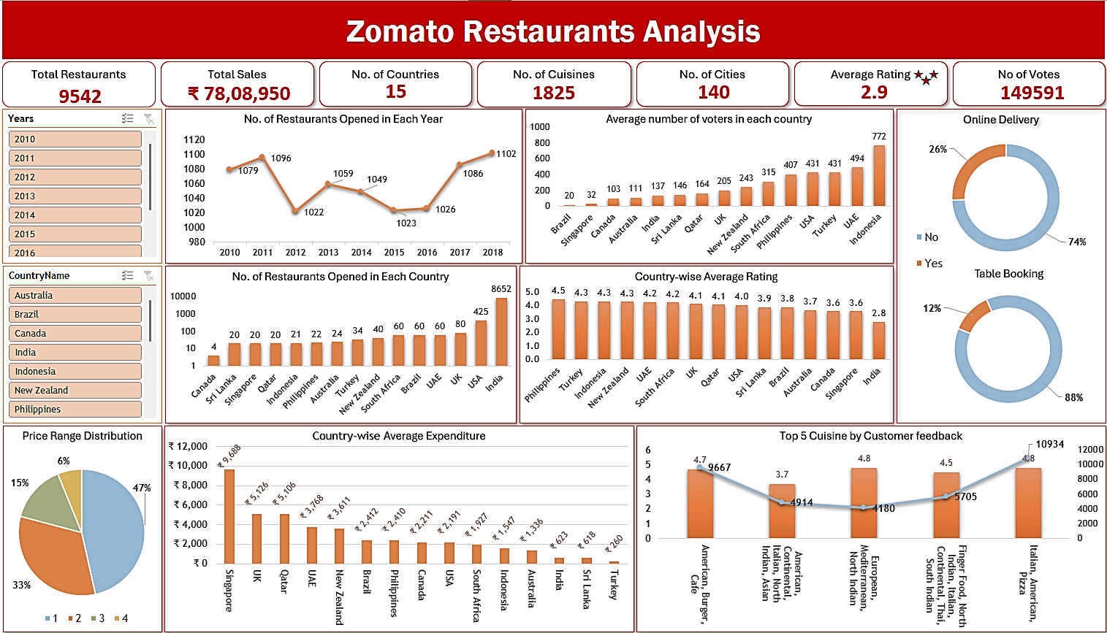

Slide 20
Dashboard and Visualization
This dashboard provides a comprehensive analysis of Zomato restaurant data across multiple countries and helps in data-driven decisions.
Overview: Zomato operates 9,542 restaurants across 15 countries, 1,825 cuisines, 140 cities, generating ₹78,08,950 in total sales. The average rating is 2.9, with 149,591 total votes.
Growth Trends: A time series chart shows the number of new restaurants opened from 2010 to 2018, highlighting growth trends and key years for expansion.
Restaurant Distribution:
India leads with 8,652 restaurants, followed by the USA with 425, and UAE with 80.
Voter engagement varies by country, with India having lower engagement despite volume.
Price range and average ratings are compared across countries, showing performance and user preferences.
Key Visuals:
Donut chart shows the relationship between offered services (online delivery, table booking) and ratings.
Bar charts highlight the Top 5 cuisines by customer feedback.
Bar and pie charts reveal restaurant counts, voter engagement, and price distribution.
Interactive Dashboard: Slicers for years, countries, and cities allow detailed, data-driven decision-making for expansion, menu strategy, and improving customer satisfaction.

Slide 21

Conclusion
Recommendations:
Analyzed Zomato data to identify four potential countries for expansion: Australia, Canada, Singapore, and Sri Lanka, based on restaurant count, ratings, and average expenditure.
Compared average expenditures across cities to narrow down recommendations. Australia and Singapore show strong growth potential due to rising demand and diverse cuisine preferences, with less competition in certain segments.
Dining costs in these regions align with global trends, offering opportunities for flexible pricing and good margins.
Expanding in these countries aligns with Zomato’s growth goals, targeting underserved services like table bookings and online delivery.
Low market saturation combined with balanced average expenditure creates less competition, attracting more customers and ultimately driving higher profits.

Slide 22


Thank You

